Slide 1
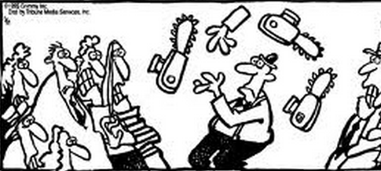
Websense’s Agile Journey
Ami Kleinman
Senior Director, Software Engineering

Slide 2
Agenda
How We Got to Agile?
Gearing up for Agile Scrum
Kicking off Agile Scrum
Assessment of Agile

Slide 3
Before Agile:
“…וְהָאָרֶץ, הָיְתָה תֹהוּ וָבֹהוּ, וְחֹשֶׁךְ, עַל-פְּנֵי תְהוֹם”
בראשית א, ב

Slide 4
How We Got to Agile
Well … actually not
Happy with our waterfall process
New VP decided on move to Agile
Had previous success with Agile
Main driver was improving quality
Local team started thinking about Agile independently
Liked tight Dev/QA interaction
Liked the emphasis on organic cross-functional teams

Slide 5
Key Decisions
Key Decisions When Moving to Agile:
Pilot with one scrum or all-in ???
Went all-in
Forming Scrums
Mostly organic scrums with dedicated QA
i.e. Engine, GUI, etc.
Dramatic impact on QA org
One scrum vertically integrated
Small infrastructure scrums (CM, Installer, UX)
Identifying Scrum Masters
Made Team Leaders the SM’s
Minimize amount of change we introduced
Not all TL’s were pro-Agile . . .
This changed over time, but many TL’s still SM’s

Slide 6
Key Decisions (Con’t)
Identifying Product Owners
Used senior development managers
Size of Scrums
Started on the large side (closer to 9 per scrum)
Over time tried to tweak down
Too small is a problem also
Scrum of Scrums
Sprint duration
Used 3 weeks
Hardening Sprint
Initially 2 hardening sprints in 4-sprint PSI (ouch!!)

Slide 7
Putting the pieces into place
Gearing up for first sprint requires effort
Agile training (SM’s and non-SM’s)
Tools training (Jira in our case)
Creating Epics/User Stories/Backlogs
First sprint pre-planning
Props (sticky cards, clocks, white board,…)

Slide 8
External Consultant
External Agile consultant was critical for us
Gave us courage to take big decisions!!!
Sanity checked our ideas
Allowed us to move more quickly
Less need to move incrementally
Helped prep for first sprint
Real-time support in early scrum meetings/rituals
reduced the emphasis on Agile mechanics
Helped coach the teams (e.g. how to do a good retro)
Perceived as neutral during disagreements
Can give more help to scrums that are struggling

Slide 9
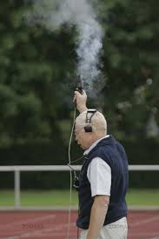
Kicking off Agile
Senior manager involvement and support is critical
Team needs to see management is fully engaged
Focus on quick adjustments at first
Try to get to demo and retrospective quickly
Agile Steering Committee
Scrum Master Forum
Track indicators (burn-down)
Expect complaints about process
Too many meetings
The meetings take too long (planning, daily, etc.)
Jira is a hassle
Burn-down is meaningless
Etc. etc. etc.

Slide 10
Assessing Agile at Websense Raanana

Slide 11
The Good
Excellent cooperation btw Dev and QA
Dev understands QA better
QA understand Dev better
Dev willing to help with QA when needed
QA Team loves SCRUM, feels empowered
Involved from day one!
Dev much more open to QA concerns
Quality
The code doesn’t become unstable
Mindset -- think a lot more about test cases, unit/regression testing earlier
Huge emphasis on automation pays dividends

Slide 12
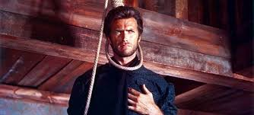
The Good (con’t)
Forces ruthless prioritization. Frequently.
Every PSI (quarterly)
Every Sprint (tri-weekly)
Emphasis on taking stuff out (for convergence)
Improved Customer Support
Now owned by the SCRUM (i.e. both Dev and QA)
We improve over time
Better at executing the rituals
shorter dailies, effective retrospectives, etc.
Better at allocating time for pre-planning and PSI planning
Continually improving our processes
Post retrospectives, Agile steering, Hardening in the scrum
More automation

Slide 13
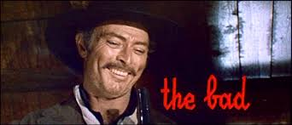
The Bad
The quality of the SM’s is crucial for success
Need right people in SM role
Need critical mass of “pro-agile” scrum members
Need SM with a sense of ownership
Project management skills help
De-emphasizes Designs
Many months for teams to acclimate
Stop complaining about meetings
Living with Jira/log work/burn-down
Allocating time for pre-planning/story time
Effective SoS meetings

Slide 14
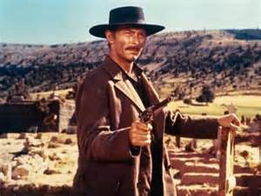
The Bad (con’t)
Keeping Jira up-to-date is a lot of effort
The engineers don’t update enough (log work)
Requires constant management attention
Creating tickets for everything
Filling out all the key fields
Etc.
Field support doesn’t fit neatly into Agile
We allocate buckets in each sprint

Slide 15
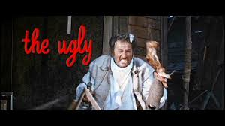
The Ugly
Take Agile Literature with a large grain of salt
Always an idealized scrum
One web eng., one DBA, 1 QA, etc.
No one is a bottleneck
Everyone can step in for everyone
User Stories split easily
Always fully self-sufficient
Agile in the real world is messy
Bottlenecks in the scrum
Dependencies on other scrums
Customer support
User Stories don’t break down easily
Sometimes you need a real design . . .

Slide 16
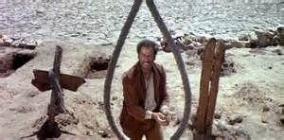
The Ugly
Good automation is critical for success . . . and no one tells you this explicitly
Automation infrastructure becomes a bottle-neck
Build environment/Rapid builds
CI and Sanity testing
Unit/Regression testing
Test env. for each scrum
Success in Agile requires significant investment in automation first year and beyond!
Spent several person years here
Improvements were well worth the effort
Critical for waterfall too
Don’t know how we managed until now

Slide 17
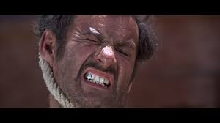
The Ugly (con’t)
Self-empowered teams is a lofty goal
Some engineers uncomfortable committing
Some engineers just don’t care about Agile
Critical mass of Agile enthusiast in the scrum is key
The tools (Jira) require customization
Hard to reach agreement in global org
Need buy-in from other teams to succeed
Tech Support – wants date for customer fixes
Product Management – wants a 3 year roadmap
Marketing needs a critical mass of features in a release

Slide 18
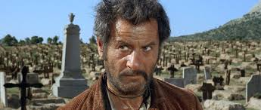
The Ugly (continued)
Are we MORE efficient with Agile?!?
Short-term: No (decreased?)
Felt efficient with waterfall
Delivered fewer features
Focused on infrastructure/CI/Automation
From weekly build to every 4 hours
From 2 hardening sprints to 1
More stable and better automation
Medium-term: We think yes
Just entering medium term now ☺
More net development time (less hardening time)
Better testing gives courage to make riskier changes
Regressions get caught more quickly reducing wasted effort

